Slide 1
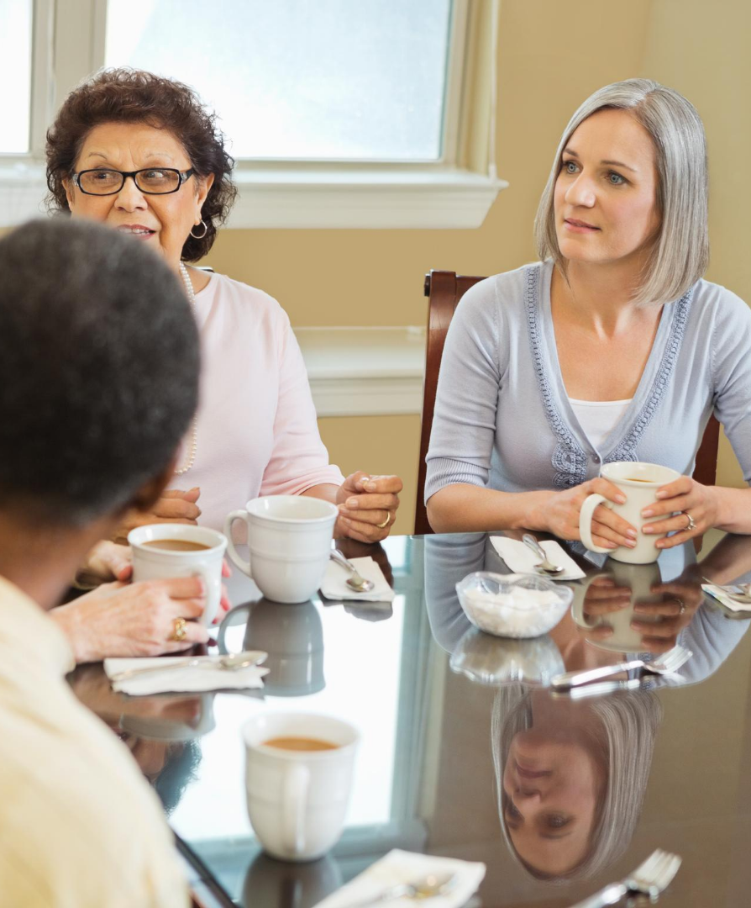

Secrets of Maximum Major Donor Engagement
Pat McLaughlin, President & Founder

Slide 2






Winning Donors’ Hearts
God, The Donor, & You
Fundraising Facts
Fundraising Plan
Donor Engagement
Holy Boldness

Slide 3


God,
the donor and you.

Slide 4
GOD, THE DONOR, & YOU
GOD REIGNS
God blesses us abundantly. (2 Cor 9:8)
God answers our prayers. Ask, seek, and knock. (Matthew 7: 7-12)

Slide 5
GOD, THE DONOR, & YOU
DONORS GIVE
69%
17%
10%
5%
Individuals
    Foundations
    Bequests
    Businesses
Source: Giving USA Foundation 2019

Slide 6

GOD, THE DONOR, & YOU
YOU ASK
If you fail to plan, you are planning to fail. (Benjamin Franklin)
Your job is to connect God’s people to God’s work through your institution and invite them to give.

Slide 7


The
fundraising facts.

Slide 8
FUNDRAISING FACTS
DOLLAR$
Bigger dollars add up faster.
You’ve got to fish in the right ponds.
Mega-major donors account for 90% of your campaign dollars.

Slide 9
FUNDRAISING FACTS
HISTORY
The first major donor campaign took place during the Exodus. (Exodus 25)
The bible is rich with stories and scripture related to asking and fundraising.
Seek encouragement from Elijah & the Widow, The Friend at Midnight, and Nehemiah.

Slide 10


Some fundraising planning basics.

Slide 11
FUNDRAISING PLANNING
EVENTS
Should you host a (virtual) mega-major donor event?
What makes (virtual) events successful?
Events vs. other donor engagements

Slide 12
FUNDRAISING PLANNING
TIMETABLES
How often to you reach out to mega-major donors?
Do you utilize a planning calendar and solicitation timetable?

Slide 13


The 6R’s of donor engagement.

Slide 14
DONOR ENGAGEMENT
OVERVIEW
Identify
Cultivate
Solicit

Slide 15
DONOR ENGAGEMENT
RESEARCH
Who do you know?
Utilize the Link – Interest – Ability method.
Look for stewardship focus, heart for ministry, appreciation for the work you do, and relationship openness.
Beware of stereotyping donor prospects.

Slide 16
DONOR ENGAGEMENT
RESEARCH
Segment your donor list.
Identify your Top 50 – 100 donors.
Utilize the Top 10 – Next 20 method.
Screen donors with Wealth Engine.

Slide 17
WEALTH ENGINE SCREEN

Slide 18
DONOR ENGAGEMENT
RELATIONSHIP
Cultivating donor relationships is key.
The donor relationship is a marriage between your mission and their values.
Know your donors (store contacts, birthdays, kids’ names, pets, interests, etc.)

Slide 19
DONOR ENGAGEMENT
RELATIONSHIP
Major gifts require 3 components:
Head
Heart
Call To Action

Slide 20
DONOR ENGAGEMENT
REQUEST
Who?
What?
When?
Where?
Why?
The right prospect.
The right project. The right gift amount.
The right time.
The right place. The kitchen table.
The right person.

Slide 21
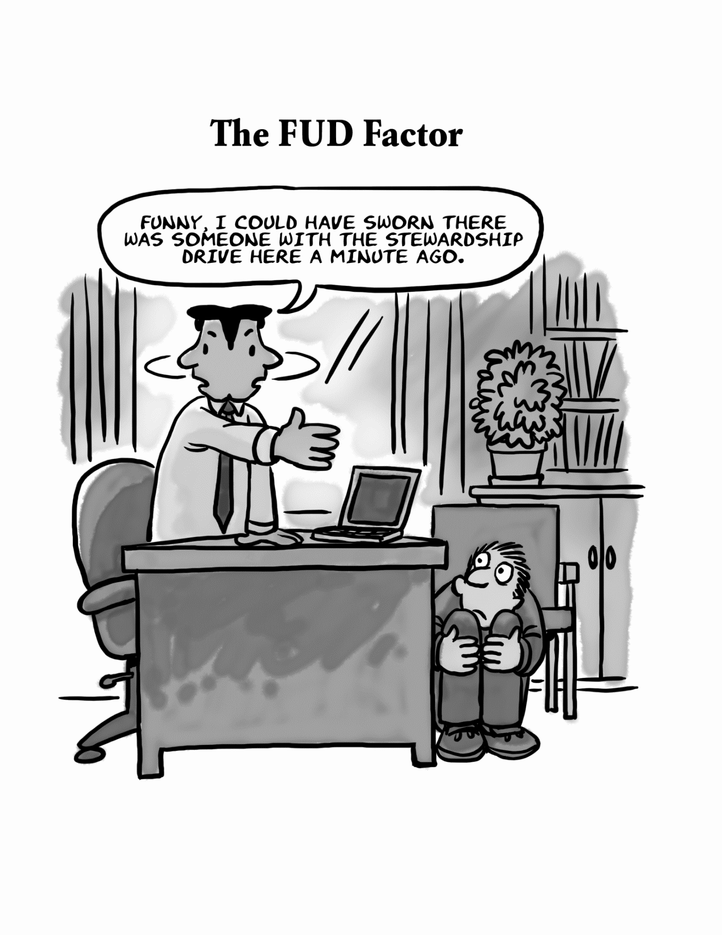
DONOR ENGAGEMENT
REQUEST

Slide 22
DONOR ENGAGEMENT
REQUEST
“I do not like to have anyone tell me what it is my duty to give. But I do like a person to say to me, ‘We are trying to raise $4,000,000, and are hoping you may be desirous of giving _____ dollars.’”
~John D. Rockefeller

Slide 23
DONOR ENGAGEMENT
REQUEST
“Based upon your understanding and appreciation for our ministry, would you consider a gift of $1,000,000?”

Slide 24
DONOR ENGAGEMENT
RECOGNIZE
Thank you
Thank you!
Thank you

Slide 25
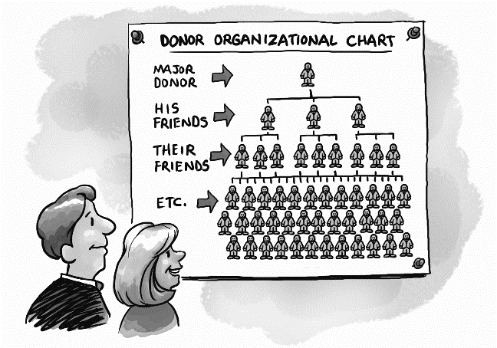
DONOR ENGAGEMENT
RECRUIT
Donors are both customers and salespeople.

Slide 26
DONOR ENGAGEMENT
RECRUIT
“Let me get this straight. I’m a little old lady with money and you want me to ask other little old ladies for money?”
“Yes, I can do that.”

Slide 27

DONOR ENGAGEMENT
REPORT
How is the gift being used?
What is the eternal impact?
Share stories of how their gift is making a difference.
Share answered prayer.

Slide 28
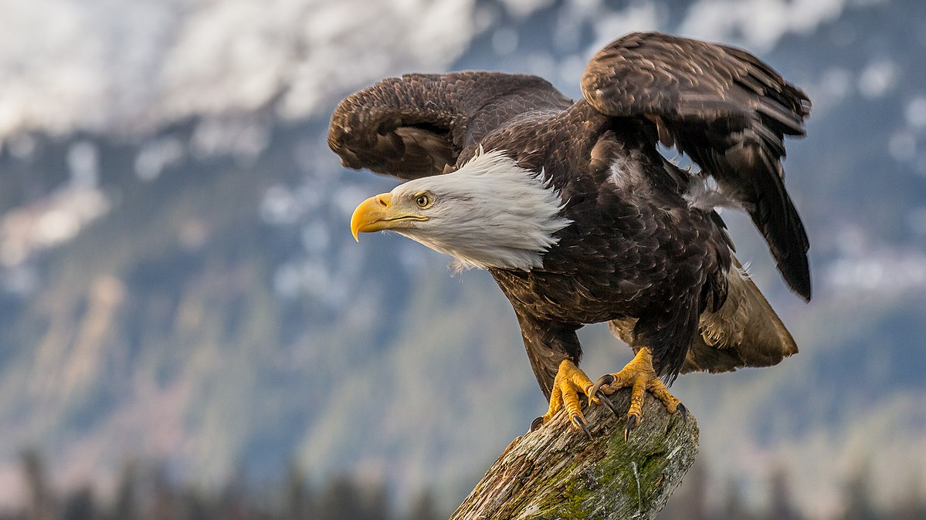

Holy Boldness

Slide 29

HOLY BOLDNESS
SCHEDULE APPOINTMENT
Thank them.
Update them.
Share your excitement.
Offer a glimpse of the vision.
Cover them in prayer.
Ask for a face-to-face (virtual) meeting.

Slide 30
HOLY BOLDNESS
THE ASK
Share your gift proposal.
Will you pray?
Will you give?
Will you friend-raise?
Will you remember us in your estate?

Slide 31
HOLY BOLDNESS
FOLLOW-UP
Answer questions.
Share additional information.
Check on their gift decision.
Pray together.

Slide 32
HOLY BOLDNESS
STRENGTHEN RELATIONSHIPS
Make personal contact (if permitted).
Make phone or virtual contact.
Email, text, or personal message.
Follow, connect, and like/share posts on social media.
Send handwritten notes & special occasion cards.

Slide 33
HOLY BOLDNESS
"Once we are prayerfully committed to placing our whole trust in God, and have become clear that we are concerned only for the Kingdom; once we have learned to love the rich for who they are rather than what they have; and once we believe that we have something of great value to give them, then we will have no trouble at all in asking someone for a large sum of money."
~Henry Nouwen~

Slide 34
QUESTIONS?
Please reach out anytime to chat.
Pat 616.437-5508
THANK YOU!

