Slide 1
Freedom of Conscience & the Challenges of LGBTQ Rights
Presenter: Dr. John Jackson
William Jessup University
© Dr. John Jackson

Slide 2
What do we hope to do today?
Understanding the issues at stake
Pressures toward compromise and compliance
Strategic options to consider
Kingdoms in conflict – insights & counsel

Slide 3
The Issues at Stake
Loss of defining moral center
Denial of Judeo-Christian worldview
Further diminishment of Biblical Authority
Challenge of cultural connection
Constitutional Republic

Slide 4
SB1146 Case Study
Removed religious exemption from higher education regulations (at one point, was going to move to government code; challenges there with employment)
Requires schools that have a Title IX exemption to notify all students, employees, etc. through multiple means
Requires schools to notify Cal Student Aid Commission if they have a Title IX exemption
Provides a private right of action if a student feels they have experienced discrimination

Slide 5
What could all of that mean?
Schools to provide notifications as required to all students and employees (included in the bill that passed)
IF schools sign the Cal Grant agreement, they will no longer be able to distinguish restrooms, housing, athletics on any basis other than self identified gender
IF schools participate in Cal Grant, any students who feels discriminated against can file a lawsuit under SB1146 provisions

Slide 6
What is the big deal?
SB1146 establishes a religious test for a generally available public benefit. Schools that do not accept the State’s narrative may not receive students who receive state monies
Students of color and first generation college students are the most negatively affected
Many schools (including Jessup) may choose to not participate in Cal Grant if SB1146 is adopted

Slide 7
Big Picture Concerns
Religious liberty concerns that are Biblical, Constitutional, Social. Church next?
Completely misses both the common good understanding of faith-based higher education and academic freedom that is embedded in higher education
The attempt to embed SOGI into 1960’s/ 1970’s legislation is rewriting history

Slide 8
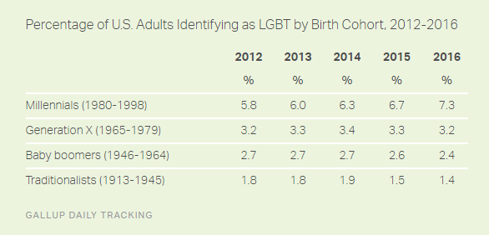
Gallup Tracking Poll 2016 http://www.gallup.com/poll/201731/lgbt-identification-rises.aspx
http://www.gallup.com/poll/201731/lgbt-identification-rises.aspx

Slide 9
So What is a College to Do?
Equip Your Board & Community with a Biblical Worldview on Biblical Authority, Gender, Sexuality, Marriage
Equip Your Board & Community with a Model for Cultural Engagement: Pre-Exilic and Exilic
Equip Your Board & Community with Political Tools to Be Salt & Light

Slide 10
Next steps
Fairness for All Legislation (connect with ADF-Alliance Defending Freedom; Greg Baylor)
www.jessup.edu/religiousliberty

